Slide 1
MOUSE AXIS CLASSIFIER
Mouse Brain Axis Classifier
Atlas-pretrained, real-image fine-tuned orientation prediction for mouse brain slices
01

Slide 2
DESIGN CHOICE
A two-stage pipeline: pretrain, then fine-tune
Unlike the human classifier, a mouse atlas alone wasn't enough. Real mouse brain photographs differ from a rendered atlas volume far more than real MRI differs from the human MNI152 template — so stage one only gets the model into the right neighborhood; stage two closes the gap.
1
2
3
Atlas pretraining
Domain-gap problem
Real-image fine-tuning
→
→
ImageNet-pretrained ConvNeXt-Tiny trained on 270 mouse atlas slices (90/axis), x4 rotation-augmented to 1,080 images. No real photos used yet.
Atlas-only model evaluated on 205 real mouse slice photos: contrast, lighting, and texture differ enough from the rendered atlas that accuracy drops sharply.
Same model fine-tuned on an 80/20 stratified split of the 205 real images, with extra augmentation for the weakest class (coronal).
Why it matters: atlas pretraining gives the model anatomical structure for free, without any manual labeling; fine-tuning then teaches it the specific visual domain (lighting, framing, tissue texture) it will actually see at inference time.
02

Slide 3
DATA PIPELINE
Atlas extraction and shared contrast normalization
528 × 320 × 456 mouse atlas volume (coronal × axial × sagittal), oriented to RAS. The same percentile-stretch normalization is then applied to every image the model ever sees — atlas slices, fine-tuning photos, and inference photos alike.
1
2
3
Volume orientation
→
Evenly-spaced slicing
→
Per-image contrast stretch
average_template_25.nrrd loaded via SimpleITK, reoriented to RAS, axes permuted to (coronal × axial × sagittal).
90 slices sampled per axis (270 total), skipping the outer 5% on each side to avoid empty edge slices — same scheme as the human atlas.
1st–99th percentile clip + rescale to [0,255] on every slice, removing brightness/black-level differences before the model ever sees them.
Why normalize everywhere, identically?
Real source folders (e.g. broadtraining/coronal vs. axial (not broad)) carry their own brightness and black-level signatures from how they were captured. Without normalization, the model can key off acquisition style instead of anatomy. The same normalize_contrast() function is called on atlas slices, fine-tuning images, and inference images — so the model is never trained on one visual regime and tested on another.
03

Slide 4
DESIGN CHOICE
Four-variant rotation
Each atlas slice is expanded into 4 fixed rotations (0°/90°/180°/270°).
270
atlas slices
(90 per axis)
0°
90°
1,080
training images
after x4 augmentation (no mirror)
180°
270°
04

Slide 5
ARCHITECTURE
Model & atlas-stage training configuration
Input
Backbone
Head
Output
320×320 RGB
(grayscale → 3-channel)
→
ConvNeXt-Tiny
ImageNet-pretrained
→
Dropout(0.4) → Linear(128)
→ GELU → Dropout(0.2) → Linear(3)
→
Softmax → 3-class
Coronal / Sagittal / Axial
Training strategy
Optimiser
Loss & class weighting
Training data
Backbone is ImageNet-pretrained ConvNeXt-Tiny, frozen for the first 4 epochs (head-only), then top 50% unfrozen at epoch 5 — same schedule as the human classifier. Early stopping, patience 8.
AdamW · lr 5e-4, weight decay 1e-4
ReduceLROnPlateau (patience 3, factor 0.5)
Gradient clipping, max norm 1.0
CrossEntropyLoss, inverse-frequency class weights — then coronal's weight is manually tripled (3.0×) on top, since coronal was the weakest class in early runs.
1,080 atlas images only (270 slices × 4 rotations). No real photos in this stage — real images appear only in the fine-tuning stage that follows.
05

Slide 6
DESIGN CHOICE
Leak-free 80/20 split, fine-tuned before any augmentation
205 real mouse brain photographs across the three classes. The split happens on original files first — augmented copies are generated separately for each side afterward, so no base image (or its rotation) ever appears in both fine-tuning and test.
1
2
3
Collect real images
→
Stratified 80/20 split
→
Augment each side separately
205 photographs gathered from coronal (74), sagittal (65), and axial (66) folders — .tif/.tiff/.png/.jpg/.bmp formats supported.
164 images for fine-tuning, 41 held out for testing — split on original files, preserving per-class proportions, before any augmentation is applied.
Both splits get the same 0°/90°/180°/270° rotations as the atlas stage, generated independently — fine-tune set grows to 656, test set to 164.
Class
Fine-tune (orig → aug)
Test (orig → aug)
Coronal
59 → 236
15 → 60
Sagittal
52 → 208
13 → 52
Axial
53 → 212
13 → 52
07

Slide 7
DESIGN CHOICE
Coronal gets extra augmentation
Every class gets the same 4 rigid rotations, with a small random affine jitter layered on top so letterbox padding can't become a per-class fingerprint. Coronal — the persistently weakest class — additionally gets 6 extra color-jittered copies per image.
Applied to every class
Coronal only — 6 extra copies/image
4 rigid rotations 0° / 90° / 180° / 270° — same deterministic scheme as the atlas stage. Random affine jitter ±6% translate, 0.90–1.10× scale, ±4° shear — layered on every rotation copy, every class, so a class whose source images share one aspect ratio can't be recognized by its padding pattern alone.
Random rotation choice one of the 4 rigid angles, picked at random, so jittered copies still cover all orientations. Same affine jitter, plus ColorJitter(brightness=0.25, contrast=0.25) — brightness/contrast only, no saturation or hue, since every image is forced to grayscale→RGB anyway. Net effect: each coronal original yields 4 + 6 = 10 training items instead of 4.
Fine-tune class weights: inverse-frequency weighting (coronal 1.85×, sagittal 1.05×, axial 1.03×), then coronal's weight is doubled again (×2.0) on top — the same “manually boost coronal” pattern used in the atlas stage.
08

Slide 8
DESIGN CHOICE
Letterbox resize and a structural (shape-only) representation
Two extra preprocessing steps run only at inference / fine-tuning time, on top of the shared contrast normalization — both aimed at stopping the model from learning shortcuts that have nothing to do with anatomy.
Letterbox resize, not stretch-to-square
Structural representation at inference
Resizes preserving aspect ratio, then pads to a 320×320 square canvas. A plain stretch-to-square would bake in a per-class squish fingerprint whenever a class's source images share one aspect ratio — axial images here are all exactly 456×528, so a CNN could learn to detect that fixed squash factor instead of real anatomy.
Otsu-threshold silhouette combined with Canny edges, replacing photographic texture with a shape-only outline before the model sees the image. Goal: make rendered atlas slices and photographed real slices look structurally similar, so the model leans on outline/shape rather than photographic texture that differs between the two sources.
Also handled: transparent PNGs are composited onto a black background before conversion, instead of a plain RGBA→RGB drop, which can leave undefined color values in fully-transparent regions.
09

Slide 9
RESULTS
Fine-tuned model — held-out test evaluation
41 real mouse images · held-out from fine-tuning · single-view inference (no rotation voting)
90.24%
37 / 41
0.9876
1.0000
0.0610
Overall accuracy
Correct predictions
Mean confidence
Median confidence
Confidence std. dev
Per-class precision & recall
Confusion matrix (rows = true, cols = predicted)
Class
Recall
Precision
Cor
Sag
Axi
Coronal
Coronal
0.8667
0.8667
Cor
13
2
0
Sagittal
Sagittal
0.8462
0.8462
Sag
2
11
0
Axial
Axial
1.0000
1.0000
Axi
0
0
13
10

Slide 10
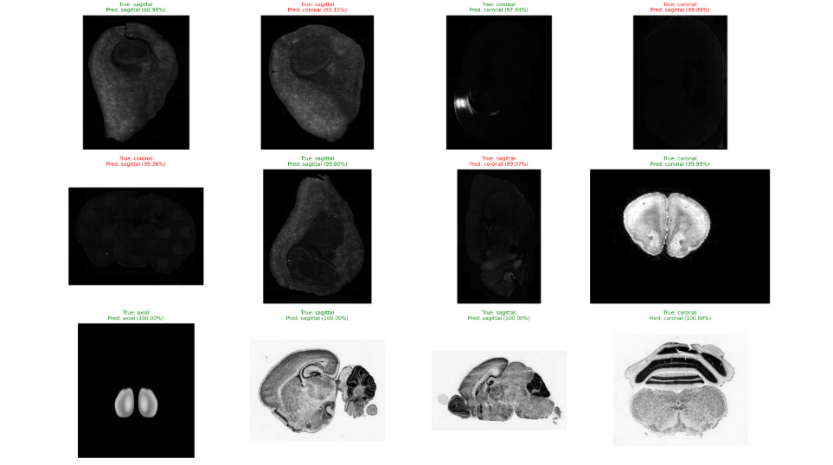
RESULTS
Sample predictions
Prediction grid — true / predicted class and confidence for representative test slices
11

